Slide 1
Software Engineering: A Practitioner’s Approach, 6/e
Chapter 11
Component-Level Design copyright © 1996, 2001, 2005
R.S. Pressman & Associates, Inc.
For University Use Only
May be reproduced ONLY for student use at the university level when used in conjunction with Software Engineering: A Practitioner's Approach.
Any other reproduction or use is expressly prohibited.
These courseware materials are to be used in conjunction with Software Engineering: A Practitioner’s Approach, 6/e and are provided with permission by R.S. Pressman & Associates, Inc., copyright © 1996, 2001, 2005

Slide 2
What is a Component?
OMG Unified Modeling Language Specification [OMG01] defines a component as
  “… a modular, deployable, and replaceable part of a system that encapsulates implementation and exposes a set of interfaces.”
OO view: a component contains a set of collaborating classes
Conventional view: logic, the internal data structures that are required to implement the processing logic, and an interface that enables the component to be invoked and data to be passed to it.
These courseware materials are to be used in conjunction with Software Engineering: A Practitioner’s Approach, 6/e and are provided with permission by R.S. Pressman & Associates, Inc., copyright © 1996, 2001, 2005

Slide 3
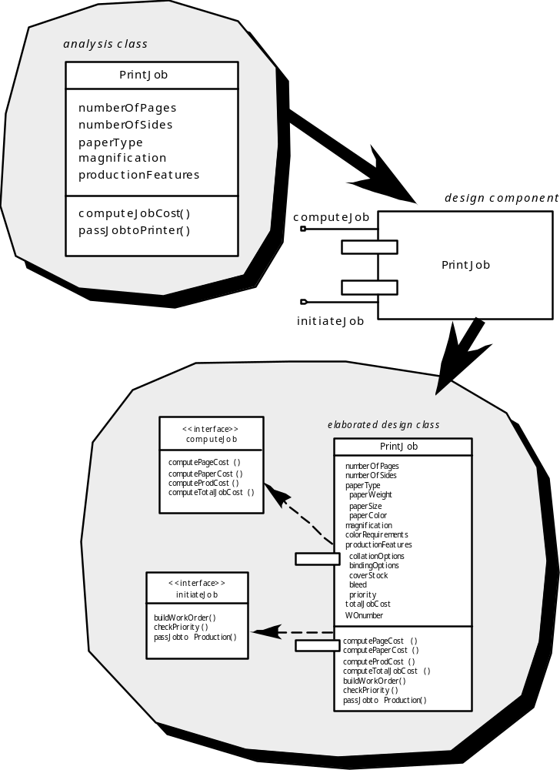
OO Component
These courseware materials are to be used in conjunction with Software Engineering: A Practitioner’s Approach, 6/e and are provided with permission by R.S. Pressman & Associates, Inc., copyright © 1996, 2001, 2005

Slide 4
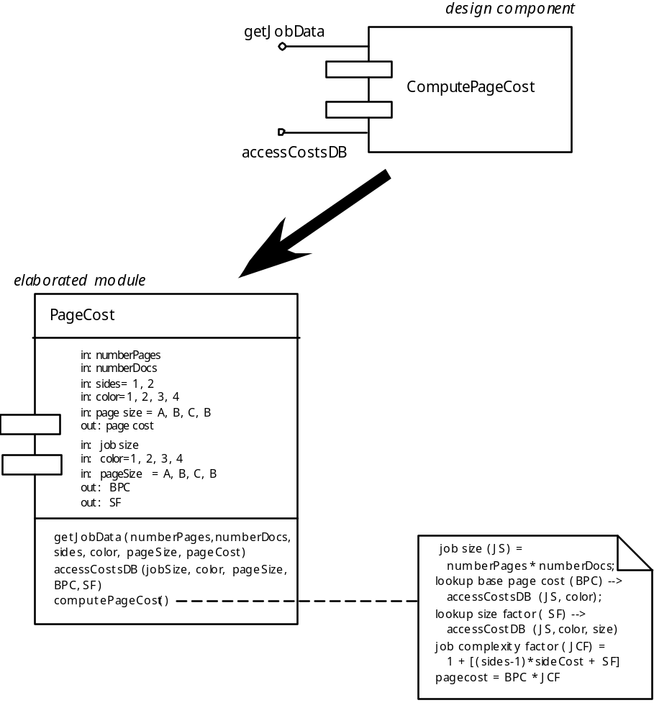
Conventional Component
These courseware materials are to be used in conjunction with Software Engineering: A Practitioner’s Approach, 6/e and are provided with permission by R.S. Pressman & Associates, Inc., copyright © 1996, 2001, 2005

Slide 5
Basic Design Principles
The Open-Closed Principle (OCP). “A module [component] should be open for extension but closed for modification.
The Liskov Substitution Principle (LSP). “Subclasses should be substitutable for their base classes.
Dependency Inversion Principle (DIP). “Depend on abstractions. Do not depend on concretions.”
The Interface Segregation Principle (ISP). “Many client-specific interfaces are better than one general purpose interface.
The Release Reuse Equivalency Principle (REP). “The granule of reuse is the granule of release.”
The Common Closure Principle (CCP). “Classes that change together belong together.”
The Common Reuse Principle (CRP). “Classes that aren’t reused together should not be grouped together.”
Source: Martin, R., “Design Principles and Design Patterns,” downloaded from http:www.objectmentor.com, 2000.
These courseware materials are to be used in conjunction with Software Engineering: A Practitioner’s Approach, 6/e and are provided with permission by R.S. Pressman & Associates, Inc., copyright © 1996, 2001, 2005

Slide 6
Design Guidelines
Components
  Naming conventions should be established for components that are specified as part of the architectural model and then refined and elaborated as part of the component-level model
Interfaces
  Interfaces provide important information about communication and collaboration (as well as helping us to achieve the OPC)
Dependencies and Inheritance
  it is a good idea to model dependencies from left to right and inheritance from bottom (derived classes) to top (base classes).
These courseware materials are to be used in conjunction with Software Engineering: A Practitioner’s Approach, 6/e and are provided with permission by R.S. Pressman & Associates, Inc., copyright © 1996, 2001, 2005

Slide 7
Cohesion
Conventional view:
  the “single-mindedness” of a module
OO view:
  cohesion implies that a component or class encapsulates only attributes and operations that are closely related to one another and to the class or component itself
Levels of cohesion
  Functional
  Layer
  Communicational
  Sequential
  Procedural
  Temporal
  utility
( Flc sptu )
These courseware materials are to be used in conjunction with Software Engineering: A Practitioner’s Approach, 6/e and are provided with permission by R.S. Pressman & Associates, Inc., copyright © 1996, 2001, 2005

Slide 8
Coupling
Conventional view:
  The degree to which a component is connected to other components and to the external world
OO view:
  a qualitative measure of the degree to which classes are connected to one another
Level of coupling
  Content
  Common
  Control
  Stamp
  Data
  Routine call
  Type use
  Inclusion or import
  External
(3c sdr tie )
These courseware materials are to be used in conjunction with Software Engineering: A Practitioner’s Approach, 6/e and are provided with permission by R.S. Pressman & Associates, Inc., copyright © 1996, 2001, 2005

Slide 9
Component Level Design-I
Step 1. Identify all design classes that correspond to the problem domain.
Step 2. Identify all design classes that correspond to the infrastructure domain.
Step 3. Elaborate all design classes that are not acquired as reusable components.
Step 3a. Specify message details when classes or component collaborate.
Step 3b. Identify appropriate interfaces for each component.
These courseware materials are to be used in conjunction with Software Engineering: A Practitioner’s Approach, 6/e and are provided with permission by R.S. Pressman & Associates, Inc., copyright © 1996, 2001, 2005

Slide 10
Component-Level Design-II
Step 3c. Elaborate attributes and define data types and data structures required to implement them.
Step 3d. Describe processing flow within each operation in detail.
Step 4. Describe persistent data sources (databases and files) and identify the classes required to manage them.
Step 5. Develop and elaborate behavioral representations for a class or component.
Step 6. Elaborate deployment diagrams to provide additional implementation detail.
Step 7. Factor every component-level design representation and always consider alternatives.
These courseware materials are to be used in conjunction with Software Engineering: A Practitioner’s Approach, 6/e and are provided with permission by R.S. Pressman & Associates, Inc., copyright © 1996, 2001, 2005

Slide 11
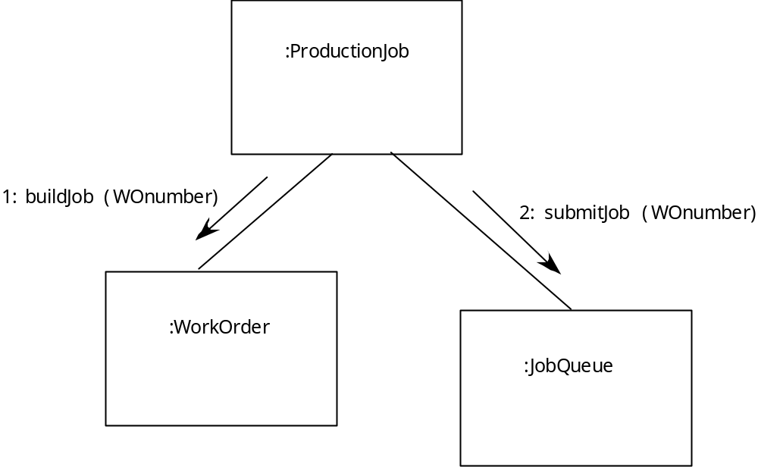
Collaboration Diagram
These courseware materials are to be used in conjunction with Software Engineering: A Practitioner’s Approach, 6/e and are provided with permission by R.S. Pressman & Associates, Inc., copyright © 1996, 2001, 2005

Slide 12
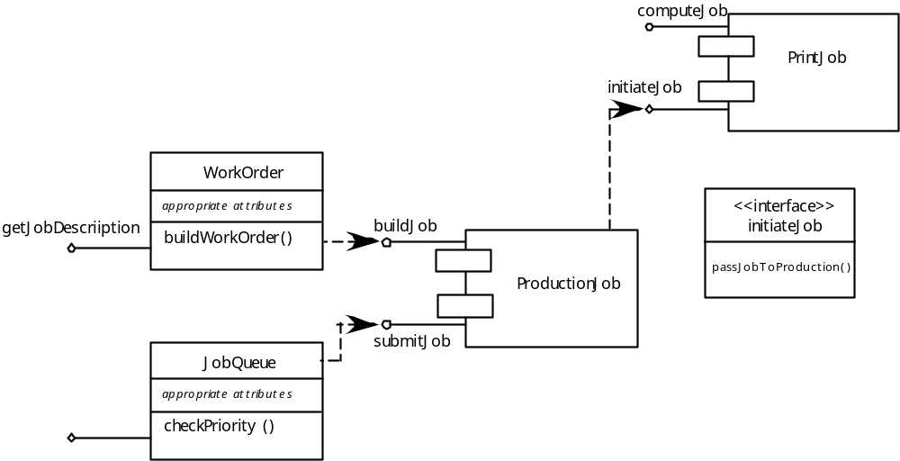
Refactoring
These courseware materials are to be used in conjunction with Software Engineering: A Practitioner’s Approach, 6/e and are provided with permission by R.S. Pressman & Associates, Inc., copyright © 1996, 2001, 2005

Slide 13
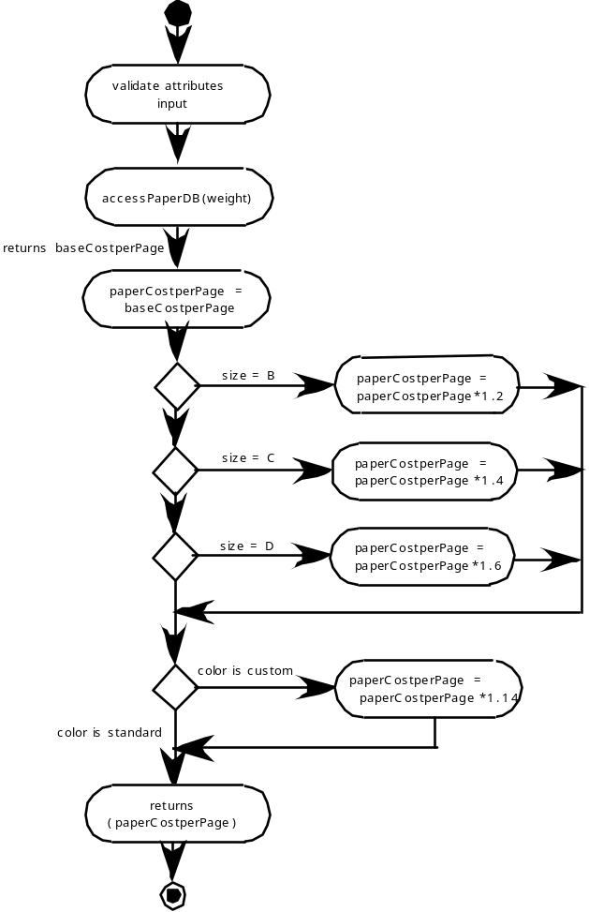
Activity Diagram
These courseware materials are to be used in conjunction with Software Engineering: A Practitioner’s Approach, 6/e and are provided with permission by R.S. Pressman & Associates, Inc., copyright © 1996, 2001, 2005

Slide 14
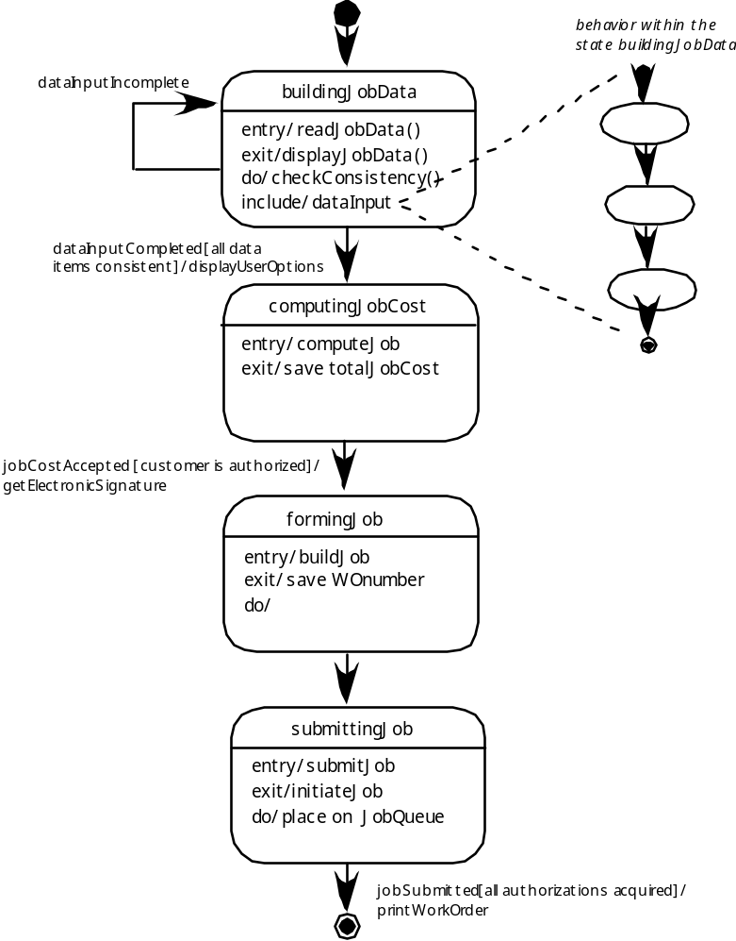
Statechart
These courseware materials are to be used in conjunction with Software Engineering: A Practitioner’s Approach, 6/e and are provided with permission by R.S. Pressman & Associates, Inc., copyright © 1996, 2001, 2005

Slide 15
Object Constraint Language (OCL)
complements UML by allowing a software engineer to use a formal grammar and syntax to construct unambiguous statements about various design model elements
simplest OCL language statements are constructed in four parts:
  (1) a context that defines the limited situation in which the statement is valid;
  (2) a property that represents some characteristics of the context (e.g., if the context is a class, a property might be an attribute)
  (3) an operation (e.g., arithmetic, set-oriented) that manipulates or qualifies a property, and
  (4) keywords (e.g., if, then, else, and, or, not, implies) that are used to specify conditional expressions.
These courseware materials are to be used in conjunction with Software Engineering: A Practitioner’s Approach, 6/e and are provided with permission by R.S. Pressman & Associates, Inc., copyright © 1996, 2001, 2005

Slide 16
OCL Example
    context PrintJob::validate(upperCostBound : Integer, custDeliveryReq :
    Integer)
    pre: upperCostBound > 0
    and custDeliveryReq > 0
    and self.jobAuthorization = 'no'
    post: if self.totalJobCost <= upperCostBound
    and self.deliveryDate <= custDeliveryReq
    then
    self.jobAuthorization = 'yes'
    endif
These courseware materials are to be used in conjunction with Software Engineering: A Practitioner’s Approach, 6/e and are provided with permission by R.S. Pressman & Associates, Inc., copyright © 1996, 2001, 2005

Slide 17
Algorithm Design
the closest design activity to coding
the approach:
  review the design description for the component
  use stepwise refinement to develop algorithm
  use structured programming to implement procedural logic
  use ‘formal methods’ to prove logic
These courseware materials are to be used in conjunction with Software Engineering: A Practitioner’s Approach, 6/e and are provided with permission by R.S. Pressman & Associates, Inc., copyright © 1996, 2001, 2005

Slide 18
Stepwise Refinement
open
walk to door;
reach for knob;
open door;
repeat until door opens
turn knob clockwise;
walk through;
if knob doesn't turn, then
close door.
take key out;
find correct key;
insert in lock;
endif
pull/push door
move out of way;
end repeat
These courseware materials are to be used in conjunction with Software Engineering: A Practitioner’s Approach, 6/e and are provided with permission by R.S. Pressman & Associates, Inc., copyright © 1996, 2001, 2005

Slide 19
Algorithm Design Model
represents the algorithm at a level of detail that can be reviewed for quality
options:
  graphical (e.g. flowchart, box diagram)
  pseudocode (e.g., PDL) ... choice of many
  programming language
  decision table
  conduct walkthrough to assess quality
These courseware materials are to be used in conjunction with Software Engineering: A Practitioner’s Approach, 6/e and are provided with permission by R.S. Pressman & Associates, Inc., copyright © 1996, 2001, 2005

Slide 20
Structured Programming for Procedural Design
uses a limited set of logical constructs:
sequence
conditional
— if-then-else, select-case
loops
— do-while, repeat until
leads to more readable, testable code
can be used in conjunction with ‘proof of correctness’
important for achieving high quality,
but not enough
These courseware materials are to be used in conjunction with Software Engineering: A Practitioner’s Approach, 6/e and are provided with permission by R.S. Pressman & Associates, Inc., copyright © 1996, 2001, 2005

Slide 21
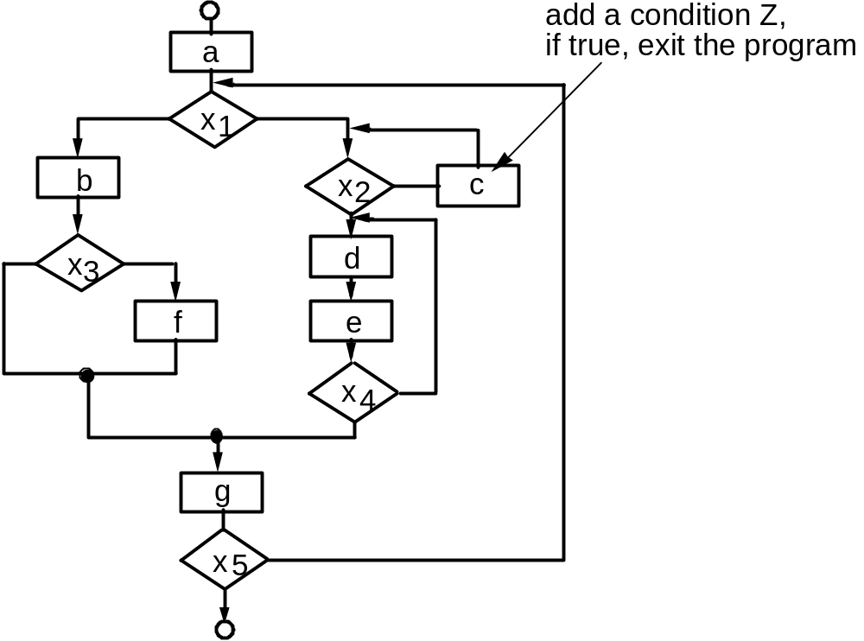
A Structured Procedural Design
These courseware materials are to be used in conjunction with Software Engineering: A Practitioner’s Approach, 6/e and are provided with permission by R.S. Pressman & Associates, Inc., copyright © 1996, 2001, 2005

Slide 22
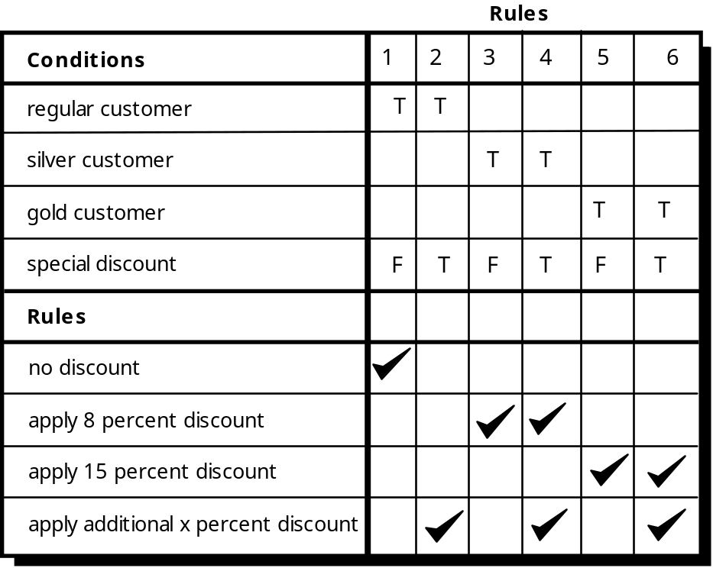
Decision Table
These courseware materials are to be used in conjunction with Software Engineering: A Practitioner’s Approach, 6/e and are provided with permission by R.S. Pressman & Associates, Inc., copyright © 1996, 2001, 2005

Slide 23
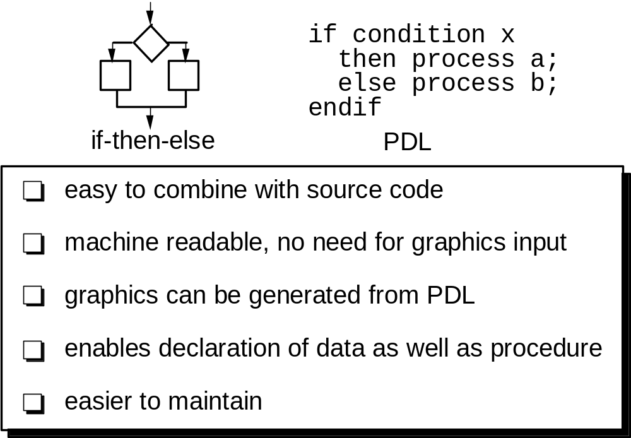
Program Design Language (PDL)
These courseware materials are to be used in conjunction with Software Engineering: A Practitioner’s Approach, 6/e and are provided with permission by R.S. Pressman & Associates, Inc., copyright © 1996, 2001, 2005

Slide 24
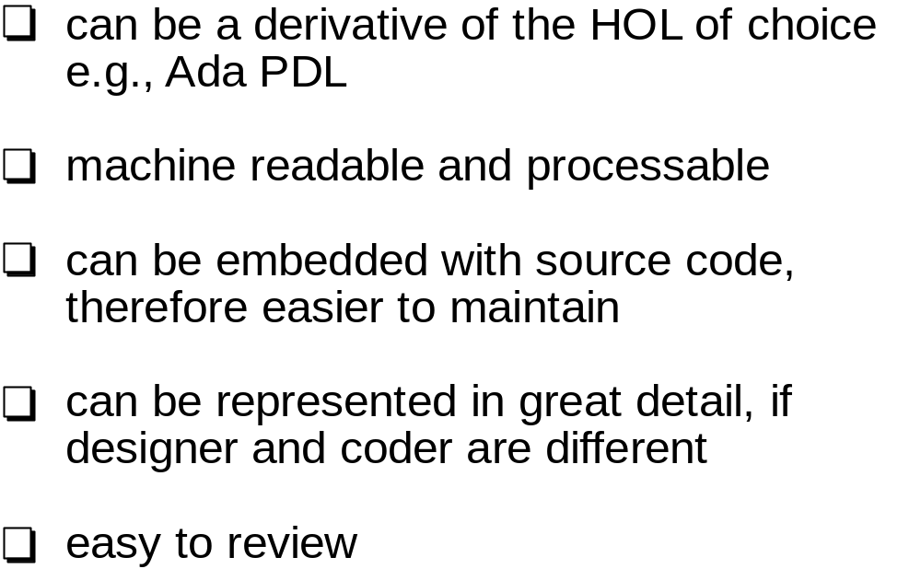
Why Design Language?
These courseware materials are to be used in conjunction with Software Engineering: A Practitioner’s Approach, 6/e and are provided with permission by R.S. Pressman & Associates, Inc., copyright © 1996, 2001, 2005

